Slide 1
Ethics Applications
Rebecca Dearman
With slides from
Ms Lynne MacRae
Faculty Research Practice Governance Manager

Slide 2
Who should be Chief Investigator (CI) and Sponsor?
Chief Investigator
Normally: Students should not normally take the role of chief investigator at any level of study, as this function should be undertaken by supervisors or course leaders.
But: Exception is made for an experienced care practitioner or manager undertaking an educational qualification for continuing professional development or a doctoral-level study while employed by a health or social care provider or a university, or for a researcher undertaking a doctoral-level study in receipt of a fellowship.
Sponsor
Normally: Universities and colleges should accept the role of sponsor for all educational research conducted by their own students
But: where the student is employed by a health and social care provider, the NHS/HSC organisation may prefer to take on the role.
UK Framework for Health and Social Care Research https://www.hra.nhs.uk/documents/1068/uk-policy-framework-health-social-care-research.pdf

Slide 3
What approvals are required?
Depends on your study!
Ethical approval – legal and policy requirements
HRA and HCRW approval – research involving the NHS in England and Wales
HMPPS – research involving prisoners
CAG – research involving access to patient identifiable data without consent
ARSAC approval – administration of radioactive substances
MHRA approval – clinical trials or new drugs or devices
Guidance:
HRA: https://www.hra.nhs.uk/approvals-amendments/what-approvals-do-i-need/
IRAS: https://www.myresearchproject.org.uk/Help/HelpPage.aspx

Slide 4
UK Policy Framework definition of Research
Generalisable or transferable new knowledge to answer or refine relevant questions with scientifically sound methods
Activities carried out in preparation for interventional research
Non-interventional research
Student research
Not service evaluations and clinical audits
Studies that do not fall under the UK Policy Framework
Do not require NHS REC or HRA approval but, may still require UREC approval*
*if Trust is sponsor and does not require ethics approval then no need to go through UREC

Slide 5
HRA/MRC decision tools
http://www.hra-decisiontools.org.uk/ethics/
http://www.hra-decisiontools.org.uk/research/

Slide 6
NHS REC requirements
Legal United Kingdom Ethics Committee Authority (UKECA) ‘Recognised’ REC | Policy
Clinical trial of Investigational Medicinal Product (CTIMP) Clinical Trial of Device Ionising Radiation Adults lacking capacity to consent (or their identifiable tissue or data) Human Tissue Act Use of confidential data outside clinical care team without consent processing of disclosable protected information on the Register of the Human Fertilisation and Embryology Authority (HFEA) by researchers, without consent | Involves NHS patients, service users or their carers (tissue/ data) Health research involving prisoners Xenotransplantation Social care funded by Department of Health Research involving analysis of human DNA extracted from acellular material
Governance Arrangements for Research Ethics Committees (GAfREC)

Slide 7
If NHS REC not required because either:
Not research
Research but outside scope of NHS RECs
If Trust is NOT sponsor then
Go back to University ethics decision tool

Slide 8
HRA and Health and Care Research Wales (HCRW) approval
HRA and HCRW approval is required for all research projects in England and Wales
Required when NHS organisation has duty of care to participants either as patients/service users or NHS staff/volunteers
Includes use of previously collected tissue or data
Research governance check on behalf of the NHS

Slide 9
Inside HRA/HCRW Approval
HRA and HCRW Approval
HRA/HCRW Assessment
Carried out by HRA assessor
Consider the study on behalf of the NHS
Data Protection
Contracts
Finance
Insurance/ indemnity
Honorary research contracts
HRA assessment criteria and standards: https://www.hra.nhs.uk/documents/217/hra-approval-assessment-criteria-standards-document.pdf
NHS REC
Carried out by independent REC
Consider ethical issues and protect the participants’
Rights
Safety
Dignity
Well-being
NHS REC Standard Operating Procedures:
https://www.hra.nhs.uk/documents/1775/RES_Standard_Operating_Procedures_Version_7.4_June_2019_lHKuibH.pdf

Slide 10
HRA/HCRW and NHS REC combinations
HRA and HCRW Approval
HRA and HCRW Approval
HRA/HCRW Assessment
HRA/HCRW
Assessment
NHS REC
e.g. studies involving patients as participants
e.g. studies involving NHS staff as participants
+ UREC?
NHS REC only
HRA does not need to see evidence of UREC approval.
UoM process requires UREC approval to be in place before submitting for HRA approval.
e.g. studies involving non-NHS participants that lack capacity to consent

Slide 11
NHS REC/ HRA Approval
Integrated Research Application System (IRAS)
Web based system (www.myresearchproject.org.uk)
Able to customise using filter questions
IRAS can be used to generate applications for:
NHS RECs
HRA approval/ R&D approval
MHRA Clinical Trial Authorisation (CTA)
HRA Confidentiality Advisory Group (CAG)
National Offender Management Service (NOMS)
Administration of Radioactive Substances Advisory Committee (ARSAC)

Slide 12
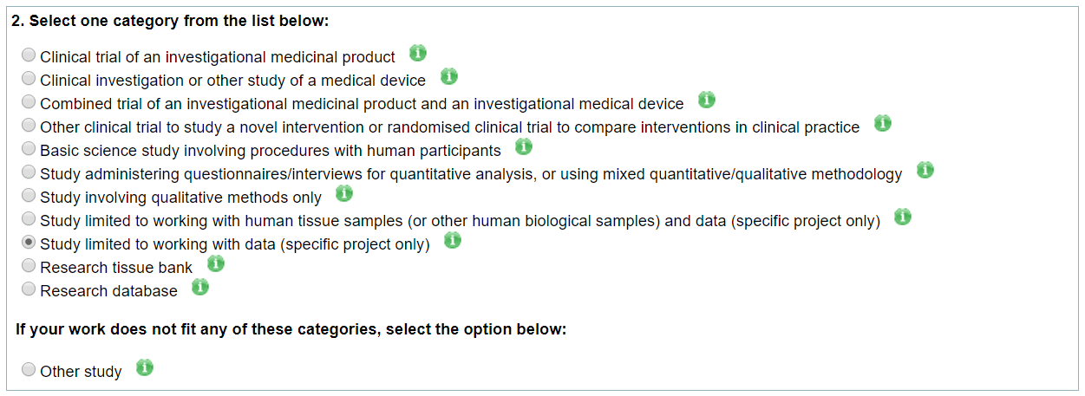
First 4 categories of IRAS
HRA guidance may highlight certain requirements for the first 4 categories of IRAS.
Interventional clinical trials/ studies

Slide 13
UREC
Ethical Review Management (ERM) system
Web based system (https://submission-ethicalreview.manchester.ac.uk/)
Able to customise using filter questions
ERM can be used to apply for:
UREC review
Division/School review (only available in certain Divisions/Schools)
Comprehensive guidance and ‘How-to’ videos available at: http://www.staffnet.manchester.ac.uk/services/rbess/governance/ethics/new-online-system-for-ethics-review-erm/

Slide 15
Documents
Protocol – mandatory for NHS REC/HRA, not always required for UREC
Participant information sheet(s) and consent form(s)
CVs
Advertising material
Assessments/measures
Distress / disclosure protocols or procedures
Evidence of sponsorship and insurance
Evidence of peer review (if available)
Risk Assessment (UREC)
Organisational Information Document and Schedule of events (HRA Approval only)
Templates and guidance:
University: https://www.staffnet.manchester.ac.uk/rbe/ethics-integrity/ethics/app-prep/
HRA/NHS REC: http://documents.manchester.ac.uk/DocuInfo.aspx?DocID=29041

Slide 16
Information for participants
Valid consent is informed consent
Information provided should be proportionate and written so that it can be easily understood.
Should consider audience when preparing documentation
Engage with patients, service users, PPIE groups where possible
Must use University template and wording but, can change order/format

Slide 17
Submitting the applications
UREC and NHS REC/HRA approval both e-submission
Study documents uploaded on to IRAS or ERM
UREC submission in ERM
NHS REC/ HRA applications booked in by calling central booking service
NHS REC/ HRA applications have to be submitted on same day as booked in

Slide 18
Full REC meeting
Once booked you will be sent details of committee and meeting time/date
Unless your study is going for proportionate review, the meeting should be attended
NHS RECs
The NHS RECs have up to 60 calendar days to review a new application
UREC
Meeting outcome sent within 7 working days
Respond to any changes within 4 weeks
Revisions reviewed by Chair within 10 working days

Slide 19
Proportionate review (PR)
Available for both NHS REC and UREC applications
Streamlined process for studies with minimal ethical issues
Reduction in the timelines No requirement to attend the committee meeting
NHS REC – determined when study booked in for review
University PR criteria http://www.staffnet.manchester.ac.uk/services/rbess/governance/ethics/guidance-on-applying-for-proportionate-urec-review/
Timelines
UREC PR – 10 workings days for decision
NHS REC PR – 21 days for decision

Slide 20
Step-by-step Summary
Use the University ethics decision tools and HRA guidance to work out what approvals you need
Complete the relevant application form (ERM and/or IRAS)
Contact the lead NHS Trust for your study at the earliest opportunity – they may want to feed into your design/application
Submit for University review:
UREC studies - submit via the ERM
NHS studies – send HRA application to FBMHethics@manchester.ac.uk for sponsor review
UREC and HRA studies – submit to UREC and then once approved, send HRA application for sponsor review
If you only need UREC approval, once you have the UREC favourable opinion letter and met any conditions, you can start
Once the IRAS is authorised, submit for HRA or any other regulatory approval
Once HRA initial outcome letter received, send UK Local Information Packs to start setting up sites
Once HRA approval received, send along with all approved documents to FBMHethics@manchester.ac.uk to start sponsor greenlight process
Send final HRA approval letter, sponsor green light email and any revised documents to the sites.
Once the sites have confirmed that they are ready to start the study, you can start the research activities.

Slide 21
Timelines
UREC
6-8 weeks for UREC review
3-4 weeks for Division Review
NHS REC
Up to 60 calendar days for full committee review (average 37days)
Approximately 10days for proportionate review
Sponsorship review
15days but may be longer during busy periods (Feb. and Nov.)
HRA approval
No timelines for HRA assessment
HRA approval dependent on other approvals being issued
Site approvals
Capacity and capability – no fixed timeline
NIHR portfolio studies - target of 70days from receipt of application to first recruitment

Slide 22
HRA approval
Before you apply for approvals
http://www.hra.nhs.uk/research-community/before-you-apply/
Applying for approvals
http://www.hra.nhs.uk/research-community/applying-for-approvals/
HRA approval
http://www.hra.nhs.uk/about-the-hra/our-plans-and-projects/assessment-approval/
Student studies led from England
http://www.hra.nhs.uk/about-the-hra/our-plans-and-projects/assessment-approval/student-studies-led-england/
Bite-size e-learning modules for students and supervisors - https://www.hra.nhs.uk/media/elearning/approval-student-researchers/story_html5.html

