Slide 1
DClinSci Year 2
Where you are at
and where you are going ?

Slide 2
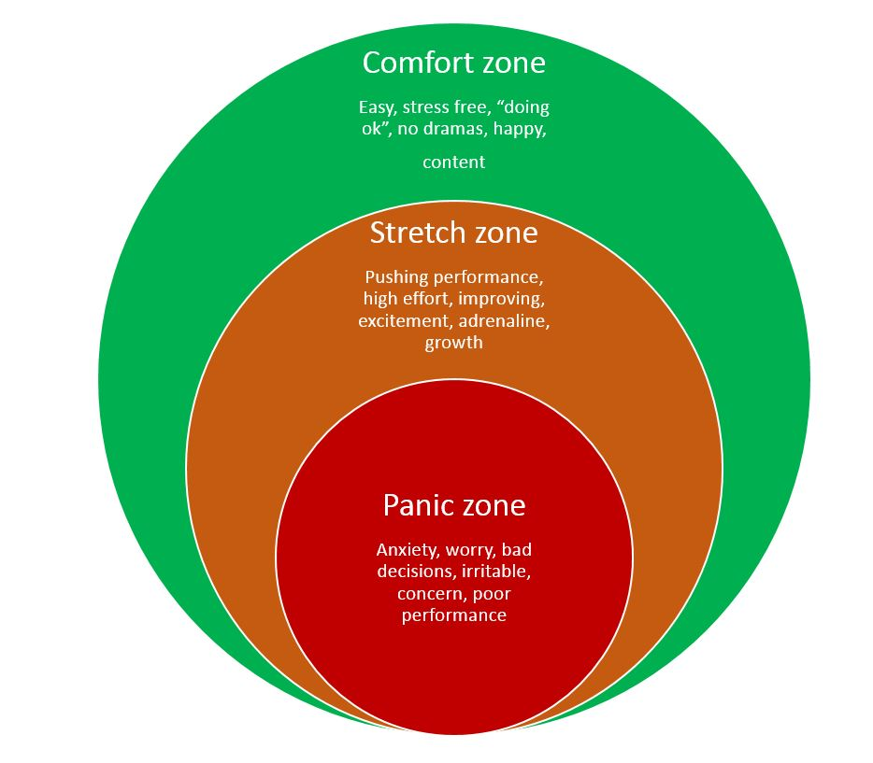
Notes:
Are you all familiar with Rohnke’s theory
Comfort stretch panic
To support you to excel in your research projects it is essential that we support you but stretch you

Slide 3
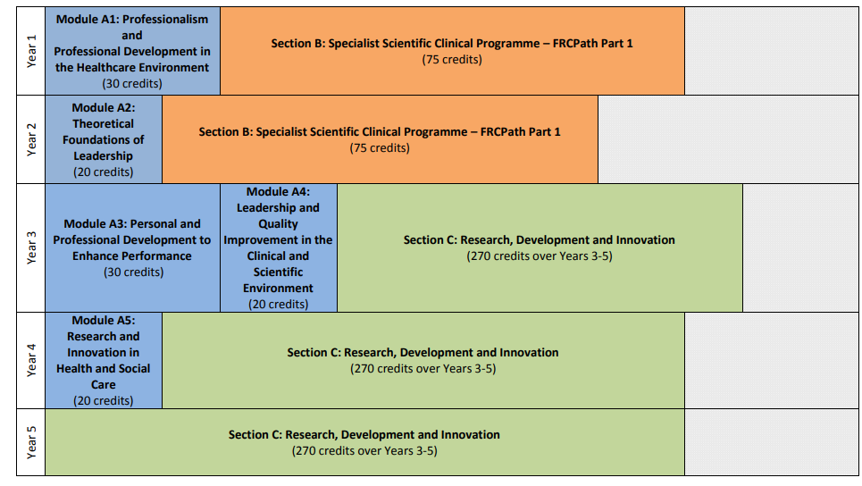
DClinSci Life Sciences Programme Structure
http://mahse.co.uk/wp-content/uploads/2018/07/DClinSci-Life-Sciences-Programme-Structure-Jul18.pdf

Slide 4
Section C Training Workshop Schedule
Years 1 and 2
  Induction - Introduction to Section C
  Project Proposal Masterclass
Year 3-start of third year (Sep/Oct).
  How to write a literature review
  How to give a lay talk
  Section C academic and workplace supervisors meetings
Years 4 and 5-January each year
  How to write a thesis
  How to write a paper
  How to give a research talk
  Section C academic and workplace supervisors meetings

Slide 5

There is no Eureka moment in designing your project!

Slide 6

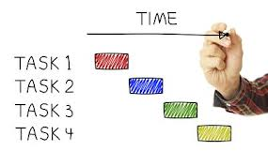
Identify the tasks
Break the project down into tasks and sub-tasks
Sub-tasks should be small enough chunks so that you can easily assess your progress

Slide 7
Drill Down
Identifying the tasks needed to complete your research project
Notes:
Then drill down
Drill Down is a simple technique for breaking complex problems down into progressively smaller parts.
To use the technique, start by writing the problem down on the left-hand side of a large sheet of paper. Next, write down the points that make up the next level of detail on the problem a little to the right of this. These may be factors contributing to the problem, information relating to it, or questions raised by it. This process of breaking the problem down into its component part is called 'drilling down'.
For each of these points, repeat the process. Keep on drilling down into points until you fully understand the factors contributing to the problem. If you cannot break them down using the knowledge you have, then carry out whatever research is necessary to understand the point.
Drilling into a question helps you...
Should not be a shopping or to do list: breakdown into tasks that can be managed and meet specific objectives
Assign to an individual: promotes responsibility and avoids micromanagement
Breakdown into subtasks as it’s very difficult to assess progress if the task is very large

Slide 8
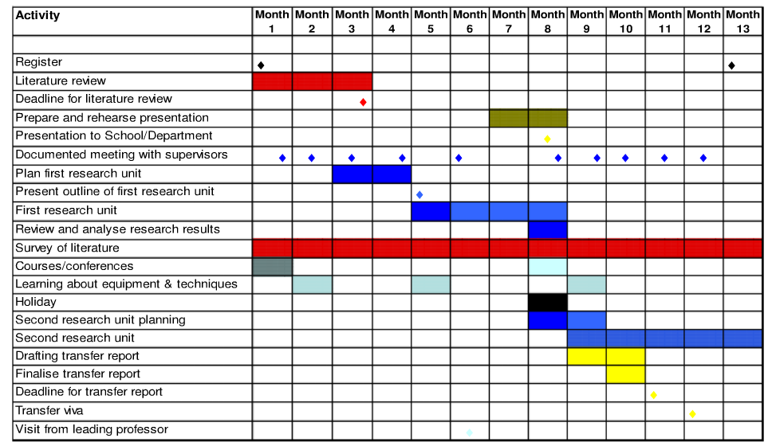

Slide 9
Develop a project timeline - Gantt chart
Objective # 2
Aug
Sep
Oct
Nov
Dec
Task 1
Enrol subjects
Task 2
Conduct interviews
Task 3
Analyse data
Task 4
Risk factor gene polymorphisms
Review
Evaluate
Notes:
Add in milestones and deliverables
Assists you in the allocation of resources
This allows you to determine if you have all of the resources that you need – such as ethical approval in order to start the project
help you to work out the critical path for a project where you must complete it by a particular date

Slide 10




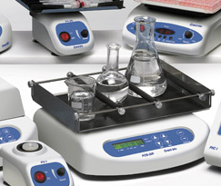


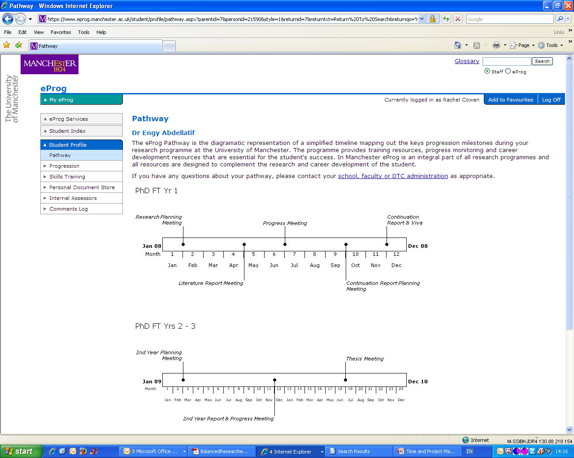
The challenges of your research project
Quality
Resources
Research hypothesis and aims
Time
Notes:
Image of requirements needed
Whats does a thesis look like
What ate the assessment criteria
What are the expectations of my supervisor

Slide 11
Engage all stakeholders in your research
Who will be affected?
Needed for support?
Interested in the outcomes?
Commissioners
Workplace supervisor
Trust
Your project
Academic supervisor
Collaborators
Faculty/HEI
How do you manage your stakeholders expectations?
Think about reporting and communication - help each to appreciate the value of the project throughout
Notes:
People who trade resources (time money values in the project
Need to manage – communication strategy important them – this is key

Slide 12
What do you need to know about stakeholders?
Who are your stakeholders?
What resources do they bring to the project?
What do they expect in return?
What’s their level of interest?
How are you going to engage them?
How can you manage them?
Are there potential conflicts between the interests of stakeholders?

Slide 13
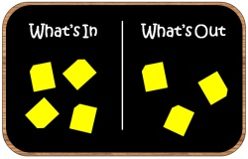
Clearly defining scope!
Scope = what needs to be done
Defines the boundaries of the project
Confirms common understanding
The scope should be agreed by all
Get agreement up front

Slide 14
Beware scope creep
Additional ideas!!!
Most common reason for projects delivering late/over budget
If you need to change the scope ensure that:
Changes are beneficial to project
Everybody is aware of
  impact on schedule
  outcomes of project
Original plan
Notes:
Note that this is not what needs to be done but a list of the project objectives and what the project will actually deliver

Slide 15

The reality of research
Things go wrong!
The direction of your research may change based on your results
New data emerges from your research field
Your project plan must anticipate all of this and more…

Slide 16
Risk analysis: What could go wrong?
Identify the risks then prioritise them
Probability – how likely is it to happen
Impact – how serious is it?
Probability
4
Minimise, eliminate or have a contingency
Impact
Impact
Notes:
Should be done at all stages of the project
Don’t put you eggs in one basket
Try to identify solutions for each

Slide 17

Struggling to develop a plan?
  This can suggest:
  Your project objectives are unclear
  You’re not convinced about the project
  The project is too large
  Unsure of your responsibilities
  Need additional support or experience
  So
  Increase resources and engage your whole team
Notes:
This is an often overlooked tool that can be very useful for managing a project. You can set up the dates across the top of the page, list your tasks in the left margin and fill in the intersecting cells depending on each task length (You would fill in every cell on the line corresponding to the task you're working with, beginning with the task start date and ending with the task end date). The primary advantage of this method is its low price. It also looks very professional and most people have Excel on their computer already so there is no expensive project software to buy.
Link out to you-tube site for how to do it

Slide 18
How will you monitor progress?
Decide on an appropriate communication/monitoring system (type and frequency)
  steering group meetings
  regular project team meetings
  weekly/monthly updates (paper or email)
Are key milestones being met?
  on time?
  on budget?
  is there a need to reassess plan?
Constant communication and transparency even when things go wrong
Notes:
Honesty is key

Slide 19
Tips on monitoring
Be systematic – evaluate against deadlines
Identify tasks which are slipping
Identify areas where additional resources might help
Identify unexpected conflicts on resources (e.g. lab equipment / technicians)
Identify critical activities and prioritise
Update project plans when things change, and always work with latest version of the plan
Most importantly BE HONEST

Slide 20
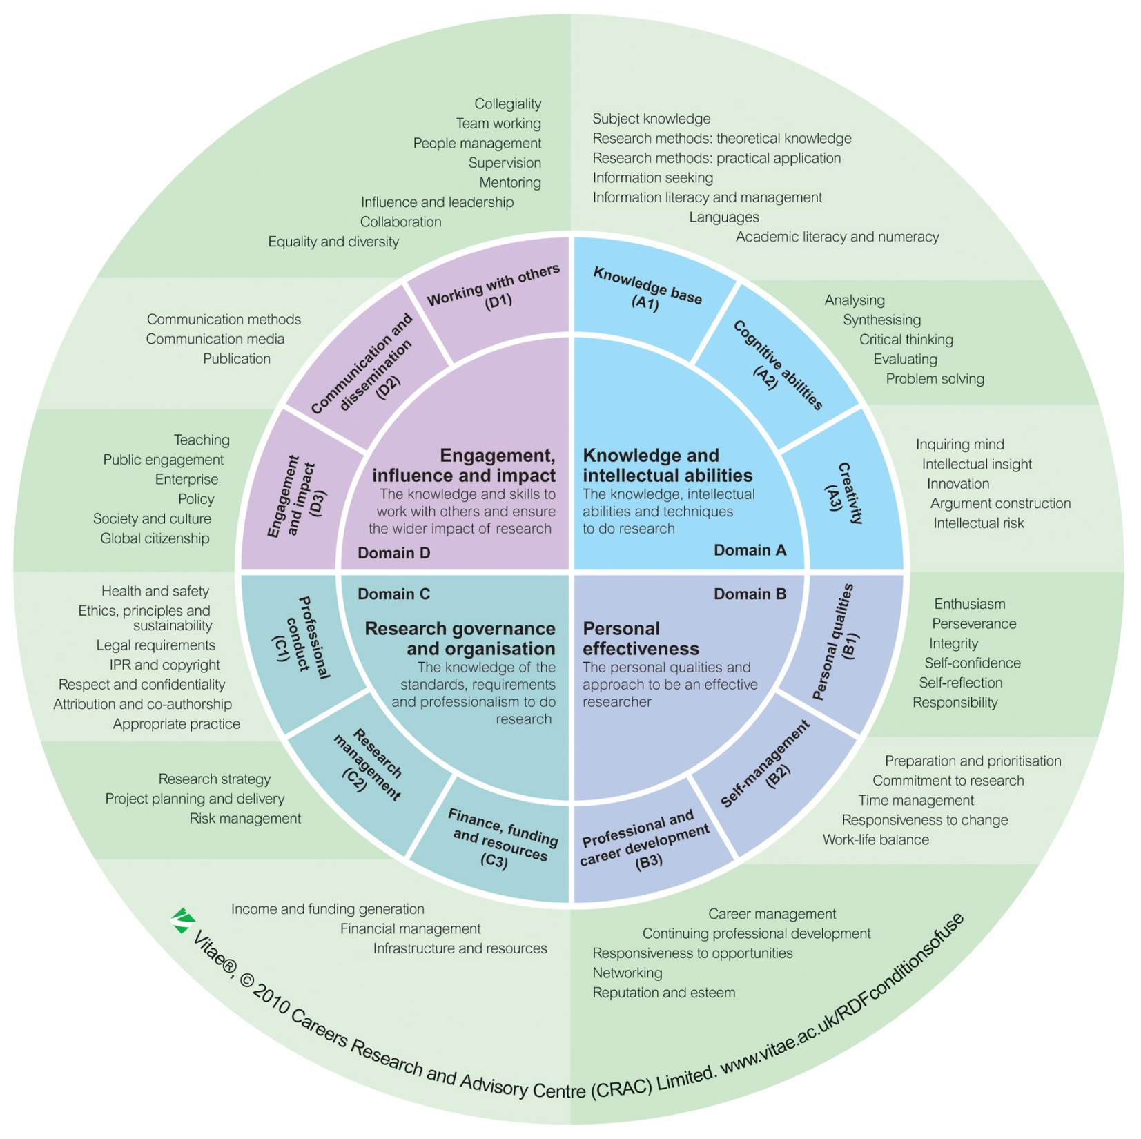
www.vitae.ac.uk/rdf
You are learning lots of generic skills

Slide 21

The good and the bad
The good
  Engaged supervisor
  Data based – main cost is my time
  Engaged bioinformatician
  Made part of my project as an MSc project
The bad
  Time time time…
  Parts of my initial plans will not be achieved (over ambitious)
Advice
  Be realistic
  Plan lots
  Start early
  Be flexible, plans and project will change and evolve

